Slide 1

Handwritten Essay Marking Software
Group 15

Slide 2
Our Team
Avishka Abeywickrama
E/18/010
Thakshila Jayathilake
E/18/156
Nirasha Sewwandi
E/18/329

Slide 3
Problem
Manual marking
Not efficient
Depends on the mood of the marker
Not consistent for all the student
Difficult when the class size increases

Slide 4
Our Solution
Tool to grade students’ handwritten essays by providing more consistent and objective grading.
Automates manual grading by using
Optical Character Recognition (OCR)
Natural Language Processing (NLP)
Machine Learning Model

Slide 5
OCR:
Scan the handwritten essays and convert them into digital text
NLP:
Identify key features such as relevance, duplication, grammar, syntax, and vocabulary
ML model:
Language : Python
ML libraries & frameworks: Tensorflow , Keras
Deploy : Rest API

Slide 6
Aim and Objectives
Aim
Objectives
Vs
Consistency and fairness for all markings
Handle large amount of files
Time efficiency
Build user friendly interface
Do the marking with acceptable accuracy via ML model
Providing detailed feedback to students

Slide 7

Solution
Architecture

Slide 8


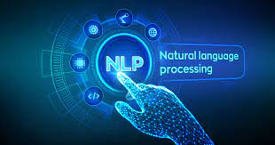
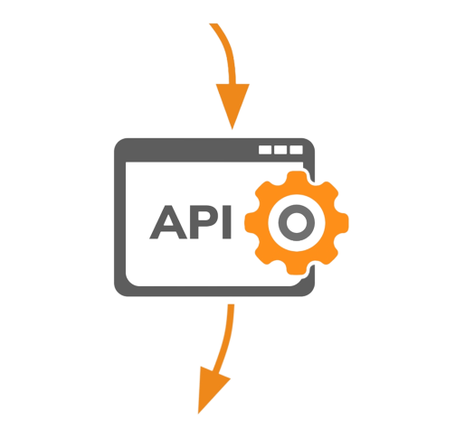

ML Model Creation
Google Cloud Vision
Google Cloud Natural Language API
ML Model

Slide 9


Data Flow
ML Model
Web Application
Database

Slide 10
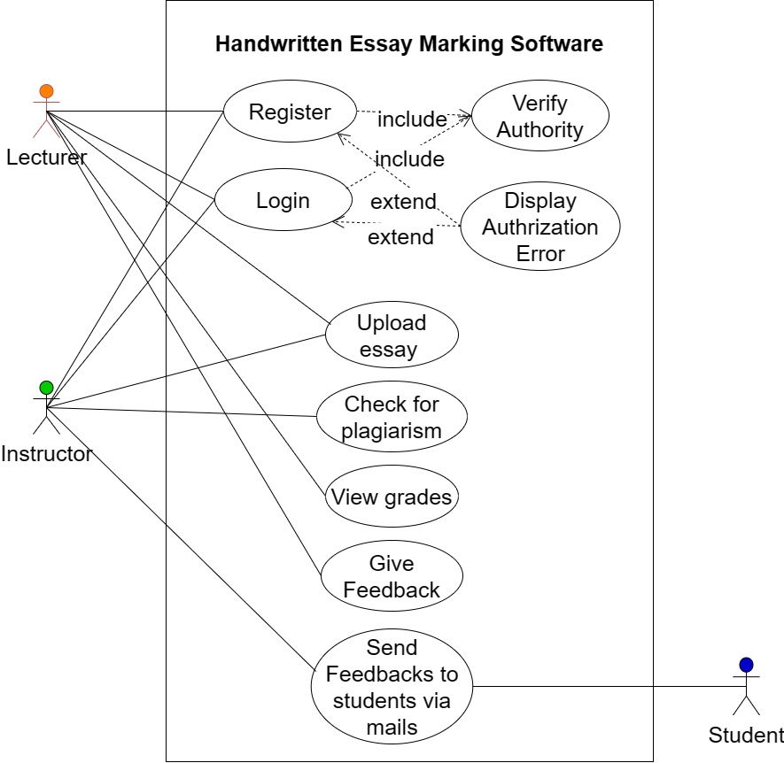
Use Case Diagram

Slide 11
Features
Automatic Grading
01
02
User friendly Web Interface
Software will grade essays based on a set of predefined criteria
Application easy to use for graders
03
04
Grades Analyzer
Plagiarism Checker
Main features of the proposed system
Visualize summary on web application
Detailing of similarity between essay & identified online sources
Feedback Option
05
Allow lectures to provide detailed feedback on each student's essay

Slide 12






Technology Stack

Slide 13
Timeline
Research and Planning
Collect data set , Extract features using NLP
Build, train and test the ML model
Develop the web application
Back end development & API testing
Testing & Deployment
7
8
9
10
11
12
13
14

Slide 14
Team strengths
UX/UI Designing
API integration
Knowledge on ANN
Fast learning

Slide 15
Thank You

Slide 16

Q & A

